Slide 1

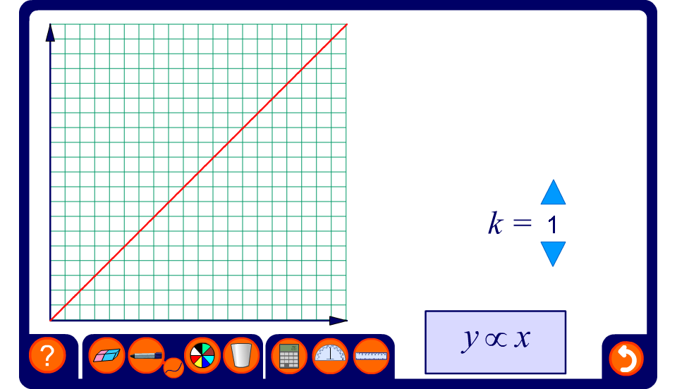


Graphs of proportional relationships
Notes:
Vary the value of k and note the basic properties of each graph.
When y ∝ x,
It is a straight line that passes through the origin.
As x increases by a fixed amount, y increases by a fixed amount.
The value of k, the constant of proportionality is given by the gradient of the graph.
When y ∝ ¹/_{x},
It is a curved line that does not pass through the origin. It never touches the x- or y-axis.
As x increases by a fixed amount, y decreases in decreasing amounts.
The greater the value of k, the steeper the graph.
When y ∝ x²,
It is a curved line that passes through the origin.
As x increases by a fixed amount, y increases by increasing amounts.
This can be investigated by using the pen tool to show how many units y increases by for each unit in the x direction.
The greater the value of k, the steeper the graph.
Explain that if y varies directly with any power of x greater than 1 a similar shaped graph will be produced.
Compare this graph with graphs then show repeated proportional change by an amount greater than 1 (that is, those showing exponential increase). See the graphs of exponential functions in A9 Graphs of non-linear functions.
When y ∝ √x,
It is a curved line that passes through the origin.
As x increases by a fixed amount, y increases by decreasing amounts.
This can be investigated by using the pen tool to show how many units y increases by for each unit in the x direction.
The greater the value of k, the steeper the graph.
Remind pupils that √x can be written as x^{½}. Explain that if y varies directly with a fractional power of x (between 0 and 1) a similar shaped graph will be produced.
Compare this graph with graphs then show repeated proportional change by an amount between 0 and 1. (that is, those showing exponential decrease). See the graphs of exponential functions in A9 Graphs of non-linear functions.

